Slide 1






Machine Learning
ANKIT MIRAJKAR

Slide 2
AGENDA
Introduction to Machine Learning
Statistics and Probability
Supervised Machine Learning
Unsupervised Machine Learning
Reinforcement Machine Learning
Projects

Slide 3

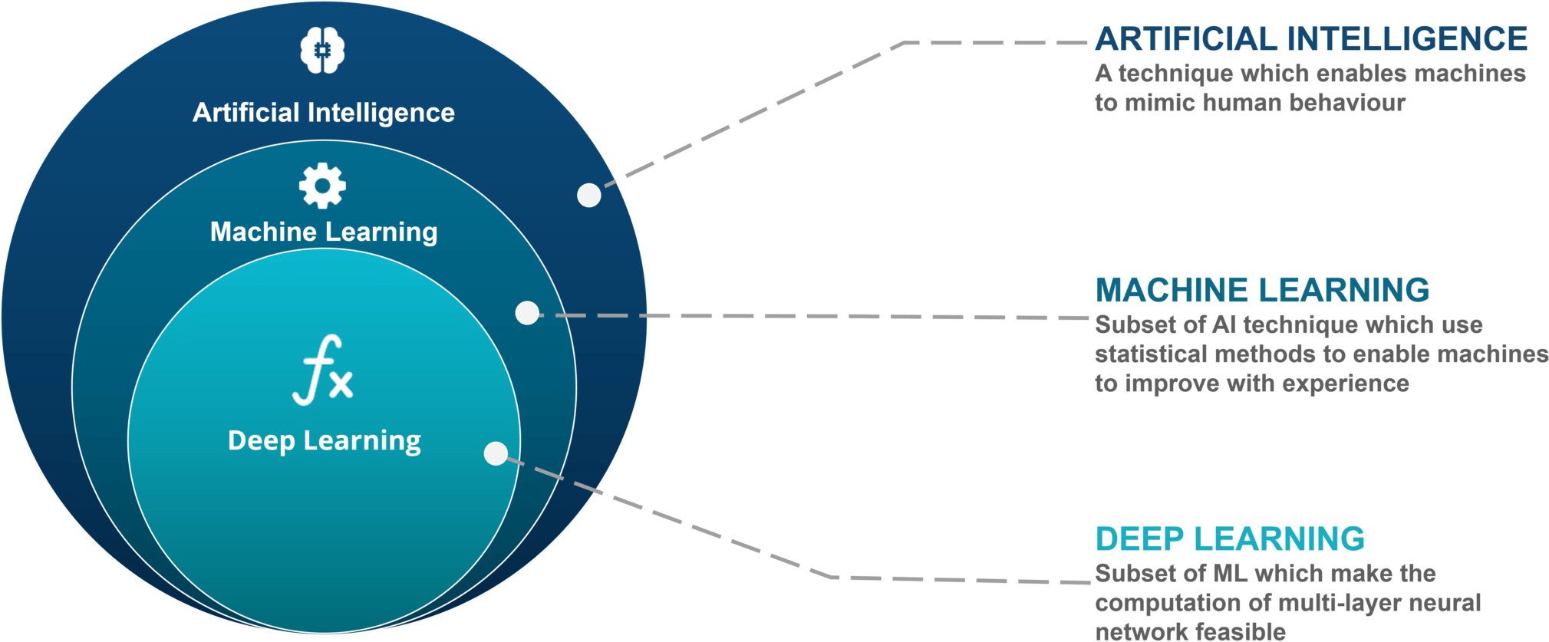
WHAT IS MACHINE LEARNING?
Machine learning is a subset of Artificial intelligence, and it focuses on designing of systems, thereby allowing them to learn and make predictions based on some experience which is data in case of machines

Slide 4
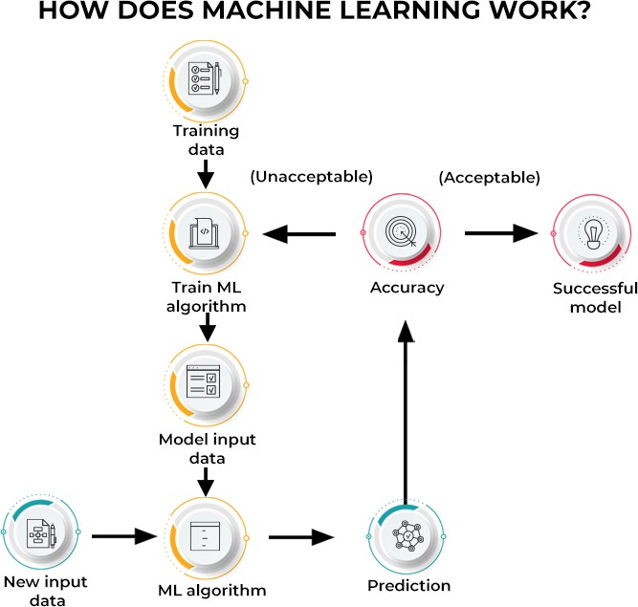
HOW DOES MACHINE LEARNING WORK?

Slide 5
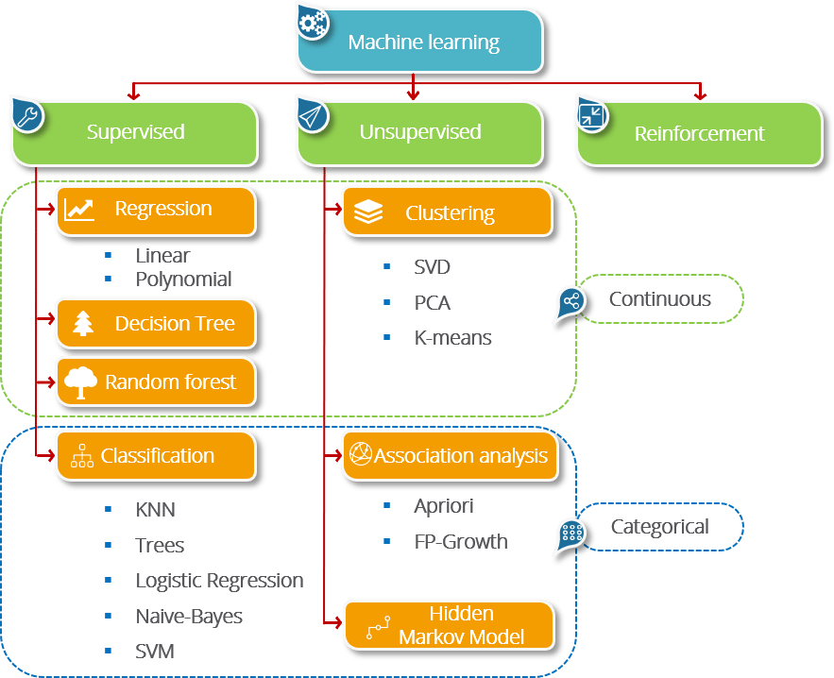
MACHINE LEARNING TYPES

Slide 6
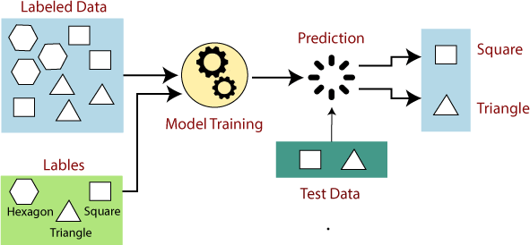
SUPERVISED MACHINE LEARNING

Slide 7
SUPERVISED MACHINE LEARNING ALGORITHMS
REGRESSION
CLASSIFICATION
LINEAR
NAÏVE BAYES
LOGISTIC
SVM
RANDOM FOREST
GENERALIZED
DECISION TREE

Slide 8
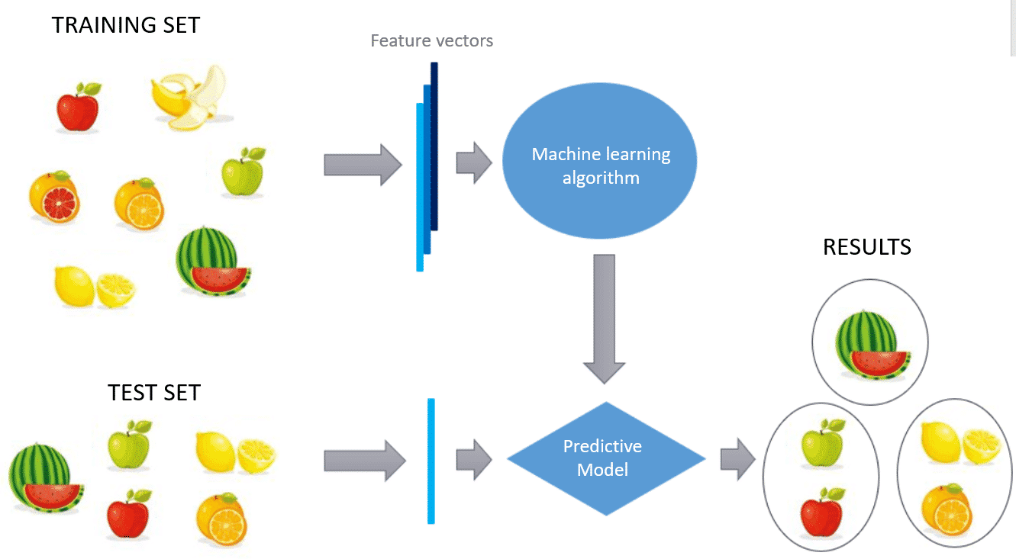
UNSUPERVISED MACHINE LEARNING

Slide 9
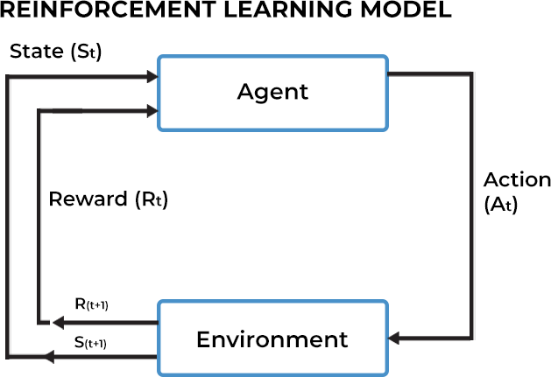
REINFORCEMENT MACHINE LEARNING

Slide 10
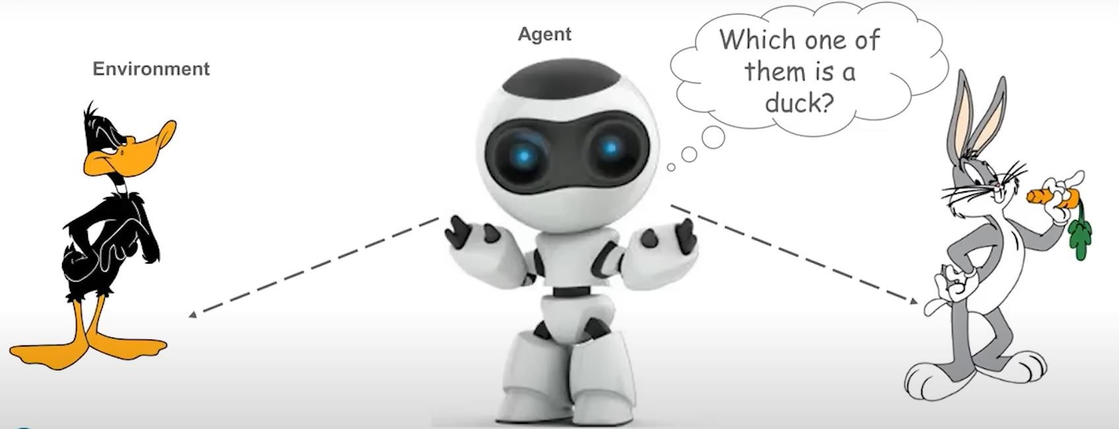
REINFORCEMENT MACHINE LEARNING
- OBSERVE
- SELECT ACTION USING POLICY

